Slide 1


Create Your Unique Value Proposition
Planner

Slide 2
SPECIAL OFFER
Want To Learn How to How To Run a Highly Successful and Profitable Launch. Go to: https://profitmagik.com/launch-accelerator-pro
Want Help Launching Your Business, Product or Course? Request a Free Strategy Session here. https://profitmagik.com/free-strategy-session/
Get 25% off our Business Acceleration Club. Use coupon code: W4DYDV6LWP. https://profitmagik.com/business-acceleration-club/

Slide 3
This Planner Belongs to

Slide 4
Why You Need A UVP
If you’ve ever struggled to explain to customers why they should buy from you, then it’s time you created a Unique Value Proposition (or UVP for short). It’s the foundation of any successful marketing strategy.
Your UVP is a statement that clearly communicates the unique value that your business, product, or service offers your ideal customers.
Defining your UVP is one of the most crucial success factors for any business because it:
Differentiates you from your competitors.
Shows you understand your customers’ needs.
Conveys concisely how you provide a unique solution to your customers’ challenges.
In this planner, you’ll follow a step-by-step process to create and communicate your compelling UVP to attract and retain loyal customers who recognize the value in what you have to offer.

Slide 5
How to Use Your Planner
Your planner is divided up into 8 steps:
Step 1: Create a Target Audience Profile
Step 2: Describe Your Product or Service
Step 3: Conduct a Competitor Analysis
Step 4: Articulate Your Value
Step 5: Write Your UVP
Step 6: Communicate Your Message
Step 7: Assess Your UVP’s Effectiveness
Step 8: Schedule UVP Check-Ins
Complete the steps in the order presented to help you create a UVP that you can effectively use in all your marketing activities.

Slide 6
Why You Want A UVP
Before you start on Step 1, it’s important to clarify exactly why you want to create a Unique Value Proposition (UVP).
Small business owners may develop a UVP for the business as a whole or for a specific product or service they want to sell.
You probably have a specific outcome in mind for this planner. Perhaps you’re just starting your business and want a compelling message that conveys what your brand is about. Perhaps you’re established and need a concise UVP to market your latest product or service.
Whatever your situation, be clear about what you need a UVP for. Then you’ll be creating the most useful statement for your current marketing needs.
Complete the questions on the next page

Slide 7
What are you creating a UVP for?
E.g., for your business as a whole or for a specific product or service.
How do you plan to use this UVP?
E.g., on your website's About page, on a sales page, and/or elsewhere.

Slide 8
Notes

Slide 9

Step 1: Create a Target Audience Profile

Slide 10
Identify Your Target Customer
How well you understand your customers can make or break a business.
Therefore, taking the time to lay out a detailed customer profile is critical. It’s your first and most essential step towards creating a UVP that resonates with the specific needs, desires, and challenges of your target audience.
Here are the key elements to investigate:
Demographics - e.g. age, gender, income, education
Psychographics - e.g. habits, behaviors, interests, values
Needs, dreams, pain points
Whether you’re looking to promote your whole business or launch a specific product or service, these elements don’t vary.
Here’s an example of the type of detail you should be looking for:

Slide 11
Example: Urban Professionals for a Health Food Brand
Demographics
Age Range: 25-40 years old
Gender: Female, but also targeting health-conscious males
Income Level: annual incomes ranging from $60,000 to $100,000
Location: Primarily in urban areas and large metropolitan cities
Education Level: Mostly college-educated professionals
Psychographics
Lifestyle Habits: Lead busy lives, with limited time for meal preparation
Interests: Strong interest in health and wellness, fitness, and sustainable living
Behaviors: Regularly consume content related to health, nutrition, and fitness; active on social media, especially Instagram and Pinterest
Values: Value quality and authenticity, environmentally conscious, willing to pay a premium for organic and sustainably sourced goods
Needs, Dreams, and Pain Points
Needs: Quick, healthy meal options that fit into a hectic schedule
Dreams: Aspire to maintain a balanced lifestyle that incorporates health and wellness without compromising their career or social life
Pain Points: Struggle to find health food options that are both convenient and genuinely nutritious; frustration with misleading health claims on products.

Slide 12
Where to Find Information
You can see from the example how detailed a target customer profile is, though there’s always room for adding more details as you learn more about your customers. Once you have this information, you’ll understand who your ideal customers are, what they want, and where you can find them.
The data you need is easily accessible online. Here are just a few ways to find information:
Create online surveys using tools like SurveyMonkey, Google Forms, or Typeform and send them to your existing customers.
Run a quick poll on your social media profiles.
Look at social media analytics from platforms like Facebook, Instagram, and X.
Review the comments and engagement on your own business social media platforms.
Join in discussions in online forums, social media groups, and industry communities.
Organize virtual interviews with a sample of your target market.
Consult review and feedback sites like Google Business, Trustpilot, Yelp, TripAdvisor.

Slide 13
Pick 3 ways to gather data on demographics, psychographics, and needs/dreams/pain points. Keep in mind the purpose of your UVP, either for your business as a whole or for a specific product/service.
1.
2.
3.
Conduct your research and from the results, create a detailed profile of your ideal customer using the template.
Demographics
Age Range
Gender
Income Level
Location
Education Level

Slide 14
Psychographics
Lifestyle Habits
Interests
Behaviors
Values
Needs, Dreams, and Pain Points
Needs
Dreams
Pain Points

Slide 15
Notes

Slide 16
Notes

Slide 17

Step 2: Describe Your Business, Product or Service

Slide 18
Describe Your Business, Product or Service
Before you can communicate the unique value of your business, product, or service, you need a clear understanding of what it is and what it does. This clarity is essential for creating a precise and compelling UVP.
To do this effectively, you need to make the distinction between features and benefits:
Features are the characteristics of your product or service - what it is and what it does. For example, physical attributes, technical specifications, capabilities, methodologies, expertise, or delivery methods.
Benefits are the value or desired outcome these features bring to your customers - how they solve problems or meet their needs.
For each feature, ask yourself:
How does this help my customer?
What problem does it solve?
How does it make my customer's life easier or better?
This is where you connect your business, product, or service to the customer's needs and desires.

Slide 19
Examples
Business: I’m a florist who specializes in custom bouquets for events (feature). The benefit for my customers is the ability to choose the exact flowers and color scheme they want that will create unforgettable memories of a special occasion.
Product: I'm launching a range of handcrafted wallets and bags made from ethically sourced leather (feature). The benefit to my customers is that they can own a durable and stylish accessory and know that they’re supporting environmental sustainability and ethical manufacturing practices.
Service: I’m promoting an executive leadership program with personalized one-on-one coaching sessions (feature). The benefit for my clients is that through individualized attention, they can hone their personal style to develop unique and powerful leadership skills and stand out in their organization.

Slide 20
Specify the features and benefits of the business, product, or service you want to promote.
Business, Product or Service
Features
Benefits

Slide 21
Write a brief description of the unique problem(s) your chosen product/service solves for your target audience.

Slide 22
Notes

Slide 23

Step 3: Conduct a Competitor Analysis

Slide 24
Explore Your Competition
It’s important to see what your competitors are up to and what they say about themselves and their offers. This isn’t so you can imitate them but so that you can find your unique spot in the market.
Gather Competitor Data
As you analyze their UVPs, you’ll be able to clarify the ways your business/product/service is different. That’s vital when you create your own UVP.
Here's how you can gather data from your nearest competitors:
Identify the competitor's UVP from their website, marketing materials, or messaging.
Analyze the key components of their UVP:
  Target audience. Who are they targeting?
  Problem addressed. What customers’ needs or problems are they claiming to solve?
  Benefits offered. What benefits are they promising?
  Differentiators. How do they claim to be different from or better than others?
Identify the strengths and weaknesses of their UVPs.

Slide 25
Identify your top three competitors:
Comp.1
Comp. 2.
Comp. 3.
Find where they publish their UVPs,
Comp. 1 | e.g. website, blog, social media
Comp. 2
Comp.3

Slide 26
Analyze their UVPs:
 | Target audience | Problem addressed | Benefits offered | Differentiators
Comp. 1
Comp. 2
Comp. 3

Slide 27
Identify the strengths and weaknesses of their UVPs:
 | Strengths | Weaknesses
Comp. 1 | e.g. how clearly they communicate their UVP, | e.g, how consistently their UVP is communicated across their channels.
Comp. 2
Comp. 3

Slide 28
Your Uniqueness
This competitor data will help you define how you can stand out in the marketplace. And this uniqueness will be part of your UVP statement.
When you review your competitors’ differentiators, you can see where there are gaps where customer needs aren’t being met. These could be ideas to develop in your own business to appeal to customers looking for additional benefits.
Example 1
Business: Organic Skincare Company
Competitor's UVP: "Natural skincare solutions for sensitive skin."
Gap analysis. This competitor focuses on natural ingredients for sensitive skin. However, they don't emphasize eco-friendly packaging or sustainable sourcing, which is also important for many customers looking for organic products.
Your UVP Opportunity. You could focus on offering organic skincare products that are sourced sustainably, use only natural plant-based ingredients, and are packaged in environmentally friendly materials. Your message would be, "Eco-conscious skincare with organic ingredients and compostable packaging, perfect for sensitive skin and the planet."

Slide 29
Example 2
Service: Bookkeeping Service
Competitor's UVP. "Efficient and accurate bookkeeping services for small businesses."
Gap Analysis. This competitor focuses on efficiency and accuracy. However, they don’t emphasize personalized service or integration with online tools.
Your UVP Opportunity. You could offer bookkeeping services that provide a personalized approach and integrate the latest financial technology for seamless financial management from anywhere. Your message might be, "Advanced bookkeeping with a personal touch. Integrating cutting-edge tech to streamline your financials.“
Example 3
Product: Wireless Headphones
Competitor's UVP: "High-quality sound and durable wireless headphones."
Gap Analysis. This competitor focuses on sound quality and durability but doesn’t talk about comfort.
Your UVP Opportunity. Your product could offer high-quality wireless ear buds that are designed for exceptional comfort during long periods of use and include advanced smart features like noise cancellation, voice assistant integration, and the ability to customize settings for ambient sound control. Your message could be "Ultimate Comfort, Advanced Sound: Ensure your listening is as comfortable as it is clear."

Slide 30
Identify any gaps where customer needs aren’t being met by your competitors. Write down how this gap could be turned into an opportunity for you
 | Gap | Opportunity
Comp. 1
Comp. 2
Comp. 3

Slide 31
Compare how your business/product/service differs from each of your competitors.
 | How your business/product/service differs
Comp1.
Comp2.
Comp3.

Slide 32
Write a brief description of what sets your business/product/service apart from your nearest competitors.

Slide 33
Notes

Slide 34
Notes

Slide 35

Step 4:
Articulate Your Value

Slide 36
Why Value Is Crucial
When you provide the value customers are looking for, they buy from you and not from someone else.
It’s not always easy to differentiate your business if you work in a crowded market. But customers don’t all look for low prices. Many favor other aspects and make choices based on dependability, reputation, or honesty as well as practical aspects that give them more of what they want.
Ask yourself what you can include to add value. For example:
Free shipping
Guaranteed 24-hour delivery
Bonuses
Extensive support package
Free setup or installation
No questions asked money-back guarantee
Customization

Slide 37
Example: Boutique Online Bookstore
You run a small online bookstore to complement your retail location, however you have to compete in a market dominated by large retailers like Amazon. Standing out in this crowded space is challenging. You decide to focus on what add-ons you can provide to attract buyers who value convenience, personalization, and customer service.
You introduce:
Free shipping on all orders, regardless of the purchase amount
Guaranteed 24-hour delivery for local areas.
Tailored book recommendations and reading lists based on customer preferences.
Personalized bookmarks designed by local artists.

Slide 38
Based on the needs and pain points of your target customers, write down what you could add to your business/product/service to increase its value to these customers and help you stand out.
E.g., free shipping, money-back guarantee, 1-hour support response time, etc.

Slide 39
Notes

Slide 40
Notes

Slide 41

Step 5:
How to Write Your UVP

Slide 42
What Makes an Effective UVP?
Every UVP needs to be clear, concise, and compelling.
It’s a statement that brings together the key elements of:
The value you offer your customers
The benefits you provide that solve your customers' problems
The difference between you and your competition
Tips for Writing Effective UVP Statements:
Avoid jargon, technical language, and humor. Your audience must understand your message right away.
Use strong, active, and persuasive language.
Highlight the benefits that you offer with your product/service to show your audience how it will help them solve their problems or meet their needs.

Slide 43
Write Your UVP
Here’s a fill-in-the-blanks template you can use to create your UVP:
[Your business/ product/ service] provides
[your target audience] with [unique feature/benefit] to
[solve a problem/ meet this need] by
[your offering's benefits/ differentiator].
Examples
Business: Cloud Storage Solutions
Our cloud storage service provides small businesses with secure, scalable storage solutions to manage their data efficiently by offering advanced encryption and easy integration with existing software.
Product: Gluten-Free Snacks
Our organic snacks provide health-conscious consumers with guilt-free, gluten-free bites made from natural, nutrient-rich, non-GMO ingredients sourced from sustainable farms.
Service: Health & Wellness Program
My fitness program provides busy professionals with customized, quick workout plans to stay fit within a tight schedule by offering 15-minute routines personalized to individual fitness levels and goals.

Slide 44
Based on your previous work, draft a clear, concise, and compelling UVP using the provided template:
[Your business/ product/ service] provides
[your target audience] with [unique feature/benefit] to
[solve a problem/ meet this need] by
[your offering's benefits/ differentiator].

Slide 45
Review and revise your UVP until you're satisfied it accurately represents your business/product/service.
If you already have a UVP, compare it to the new one you just wrote. Ensure your new UVP conveys how your business/product/ service meets a specific need your ideal customer has.

Slide 46
Notes

Slide 47

Step 6:
Communicate Your Message

Slide 48
Where Will You Publish Your UVP?
Now you have your UVP, you need to make sure people know about it.
Start by picking channels and platforms where your audience is most likely to find you.
Channels for publishing your UVP include:
Website
Social media
Email marketing
Sales materials
Blog posts, videos, and podcasts
Webinar
Keep Your UVP Consistent
While your UVP should project a consistent message across all your channels and platforms, you may need to adapt it slightly for each one.
For example, you may need to:
Shorten it for social media posts.
Expand it for blog posts.
Use it in different formats, e.g. audio, or video.

Slide 49
Which social media platforms do your target customers use most?
E.g., Facebook, Instagram, YouTube, Pinterest, X.
Pick the channels and platforms that best suit your audience.
Channel | Platforms
e.g., Website | WordPress
e.g., Social Media | Facebook, Instagram, & X

Slide 50
Specify any changes you need to make to your UVP to integrate it into each chosen channel.
Schedule publishing your UVP across these channels.
Channel | Publish Date

Slide 51
Notes

Slide 52
Notes

Slide 53
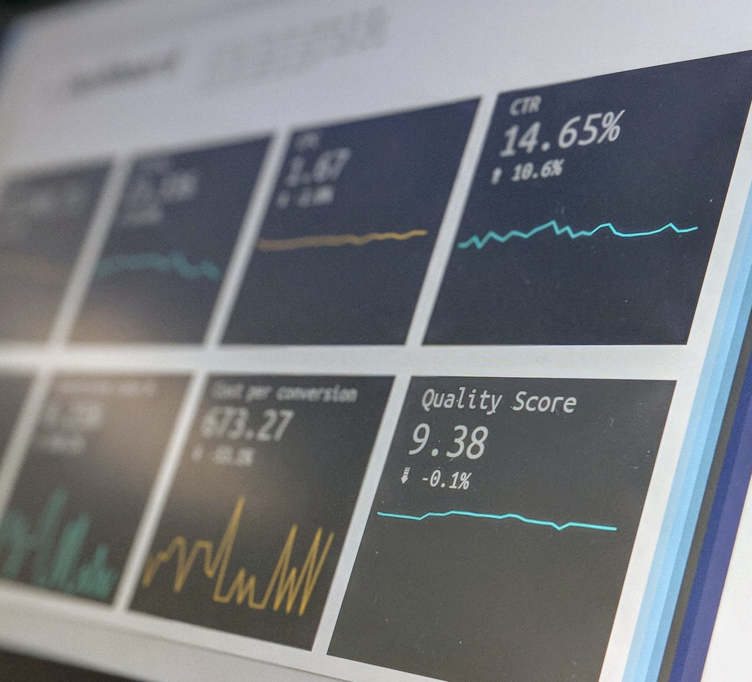
Step 7: Assess Your UVP’s Effectiveness

Slide 54
Assess Your UVP’s Effectiveness
Even though you defined your target audience earlier, you need to make sure that your UVP resonates with the ideal customers you identified.
Testing can provide valuable insights about your potential customers and their preferences so that you can refine your target audience and your UVP as you learn more about them.
There are various ways to test that this is the case, for example:
Send out surveys to hot leads.
Set up one-on-one conversations with trusted customers.
Set up A/B testing for one of your channels.
When you see the results of your testing, you’ll be able to judge which messages customers respond to best and take appropriate action.

Slide 55
Specify how you will test your UVP.
E.g., A/B testing on your website, customer surveys for past customers, etc.
Implement your testing plan and write down any feedback or data you gathered.

Slide 56
Analyze the feedback/data and identify areas for improvement.

Slide 57
Notes

Slide 58
Notes

Slide 59

Step 8:
Schedule UVP Check-Ins

Slide 60
Schedule UVP Check-Ins
You’ve created and tested your UVP. However, it isn’t set in stone.
It’s crucial to review it regularly and update it when needed so it’s still relevant and continues to serve its purpose as a foundational element of your marketing.
Here are some instances when you might need to update your UVP:
Shifts in customer preferences
Introduction of new products/services
Changes in market trends
New technology introduced into your products or services
Planned rebrand with new brand identity and messaging
Insights and feedback from customers pointing to areas for improvement

Slide 61
Set a date in your calendar to review your UVP, three months from now.
Review Date
Set reminder alerts for the review date.
Reminder 1
Reminder 2
Reminder 3

Slide 62
Write down what changes in your business or market might prompt a UVP update.

Slide 63
Congratulations!
Well done on completing this planner and creating your compelling Unique Value Proposition. You’ve taken a big step forward in your marketing effectiveness.
Remember, a strong UVP is a living, breathing part of your business strategy, evolving as your business grows. Stay tuned in to your customers' feedback, checking in with them on a regular basis. And keep a close eye on market trends that could affect your business and marketing. This continuous learning and improvement will ensure your UVP remains relevant and impactful.

Slide 64
Notes

Slide 65
Notes

Slide 66
Notes

Slide 67
Notes

Slide 68
Notes

